Slide 1
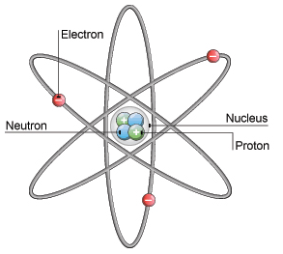
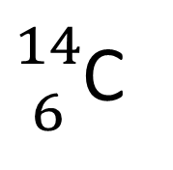
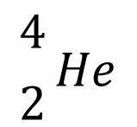
Daily Review
$${4 \atop 2}He$$
Atomic Symbols
An atomic symbol always includes:
The symbol of the element
The atomic number (in front of and below the element symbol)
The atomic weight (in front of and above the element symbol)
Write the atomic symbol for carbon-14.
Draw a neutral atom of carbon-14.
${14 \atop 6}$C

Slide 2
Daily Review
CFU 1
Draw the electron shell diagram and write the electron configuration of chlorine.
Filling Electron Shells
Electron shells can only hold a limited number of electrons.
The first shell holds up to 2 electrons
The second shell holds up to 8 electrons
The third shell holds up to 18 electrons
The number of electrons is listed in order from the innermost shell to the outermost shell, separated by commas.
For example, the electrons in a nitrogen atom can be shown as: 2, 5
CFU 2
Draw the electron shell diagram and write the electron configuration of magnesium.

Slide 3
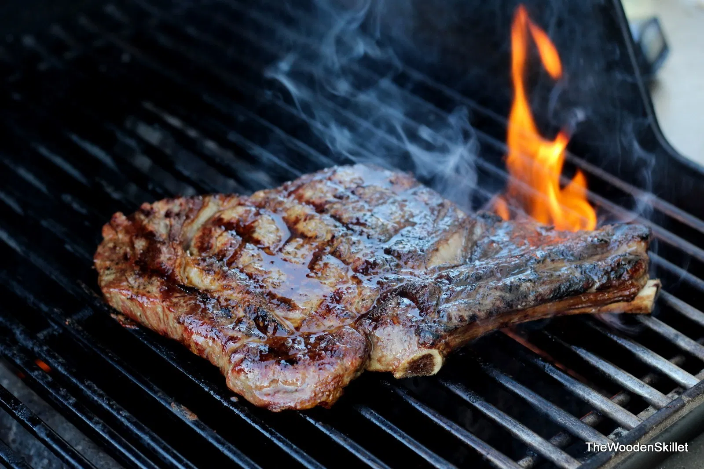
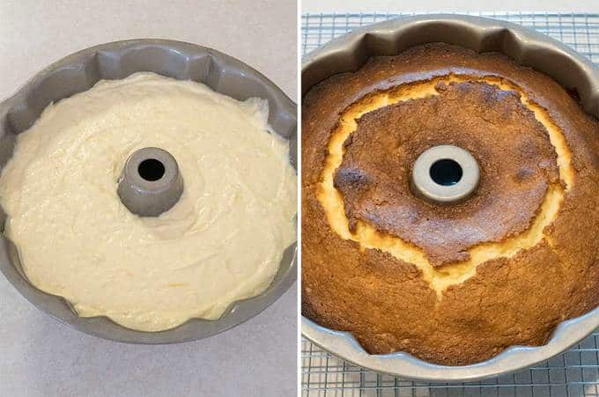
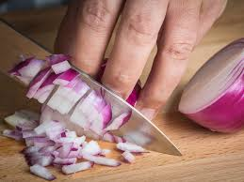
Daily Review
1
In a chemical change, also known as a chemical reaction, at least one new substance is formed.
This new substance has different properties to the original substance.
Some signs a new substance is formed could be:
Bubbles of gas are formed
Light or heat are produced
A permanent colour change
For each of the pictures shown, decide if it is a chemical reaction or not. Explain your choice.
2
3

Slide 4
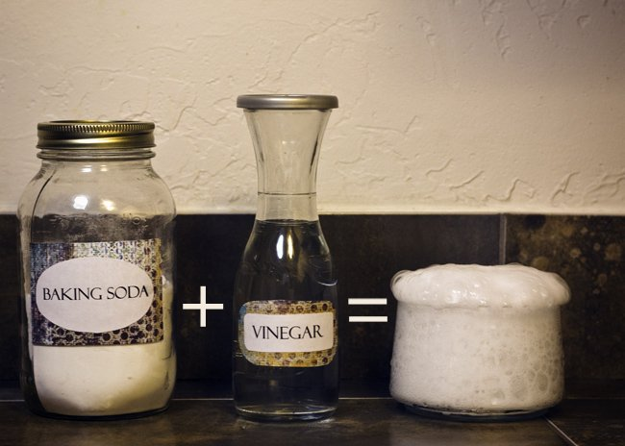
Daily Review
The products of a chemical reaction are the new substances formed.
The substances you start with in a chemical reaction are called the reactants.
Chemical reactions rearrange the elements in the reactants to form the products.
Think, pair, share: How are the products of a reaction different to the reactants?
Think, pair, share: What happens to the elements during a chemical reaction?

Slide 5
Daily Review
The products are the substances formed in the reaction.
The starting substances are called the reactants.
Identify the reactants and products in the reaction below:
When carbon reacts with oxygen, carbon dioxide is formed.

Slide 6
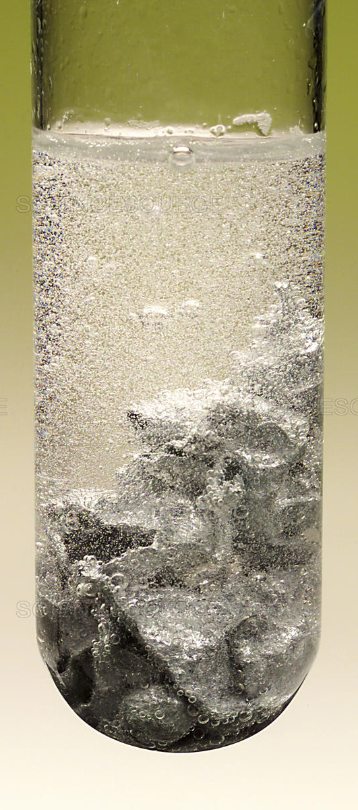
Daily Review
Writing Word Equations
Identify the reactants in the reaction and write them first, with plus signs between each one
Write an arrow at the end of the reactants
Identify the products in the reaction and write them after the arrow, with plus signs between each one
Nitric acid is poured over zinc metal. It produces zinc nitrate and bubbles of hydrogen gas.
Reactants
Nitric acid + Zinc
Products
Zinc nitrate+ Hydrogen
→

Slide 7
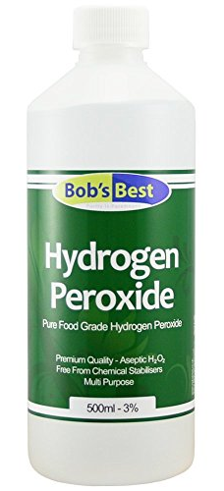
Daily Review
Writing Word Equations
Identify the reactants in the reaction and write them first, with plus signs between each one
Write an arrow at the end of the reactants
Identify the products in the reaction and write them after the arrow, with plus signs between each one
Water and oxygen are produced when hydrogen peroxide slowly decomposes when it is exposed to sunlight.
Hydrogen peroxide
Water + oxygen
→

Slide 8
Exothermic and Endothermic Reactions Year 9 Science

Slide 9
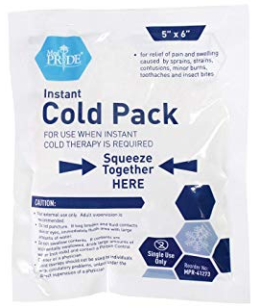
Learning Objectives
CFU
What are the two types of chemical reactions we are learning about?
Define exothermic and endothermic reactions.
Describe the energy changes involved in exothermic and endothermic reactions.
Activate Prior Knowledge
When you injure yourself while playing sport, you might use a cold pack like the one shown.
Think, pair, share: What happens when you squeeze the sides of the packet together?

Slide 10
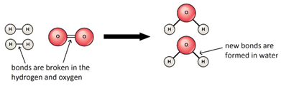
Concept Development
CFU 1
Where is chemical energy stored?
Breaking Bonds
All substances contain chemical energy, stored in the bonds between the atoms.
The bonds between the atoms are broken during a chemical reaction and reformed when the new substance is created.
CFU 2
What has to happen in order for a new substance to form?

Slide 11
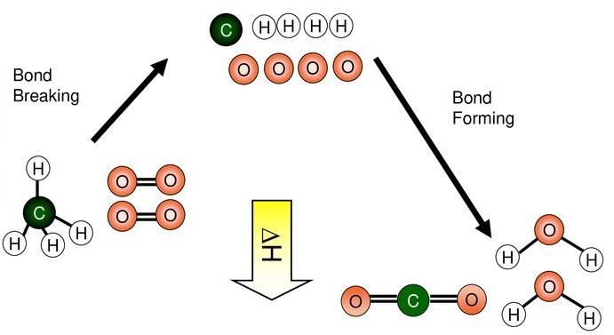
Concept Development
CFU 1
Explain how water is formed from hydrogen and oxygen, in terms of breaking bonds.
Breaking Bonds
When methane reacts with oxygen, the bonds in the methane and the bonds in the oxygen molecules are broken.
The atoms are rearranged to form water and carbon dioxide, forming new bonds.

Slide 12
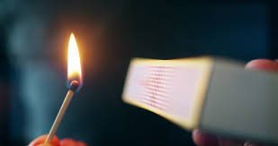
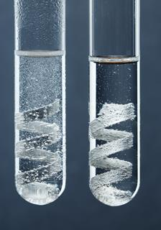
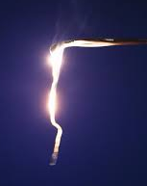
Concept Development
CFU 1
What is an exothermic reaction?
Exothermic Reactions
Reactions that release energy are called exothermic reactions.
The word exothermic is derived from
‘exo’ meaning external or outside and
‘thermic’ meaning heat
The energy released is usually heat energy, but can also be other forms including light and electrical.
Examples of exothermic reactions are:
Lighting a match
Hydrochloric acid reacting with magnesium
Magnesium reacting with oxygen
CFU 2
Where does the word exothermic come from?
CFU 3
What is released from an exothermic reaction?
CFU 4
Why are each of these reactions considered to be exothermic?

Slide 13
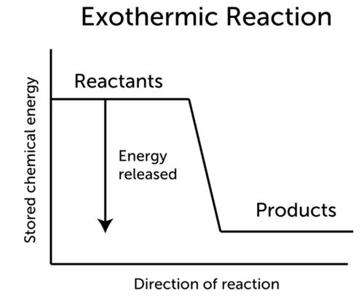
Concept Development
CFU 1
What is an exothermic reaction?
Exothermic Reactions
Reactions that release energy are called exothermic reactions.
The energy produced by breaking bonds in the reactants is more than what is needed to form the products.
This means there is unused energy, which we observe as heat and/or light.
CFU 2
How do we observe the unused energy?
CFU 3
Explain why there is energy that is not used in the reaction.

Slide 14
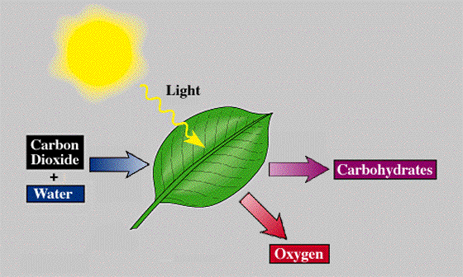
Concept Development
CFU 1
What is an endothermic reaction?
Endothermic Reactions
Reactions that absorb energy are called endothermic reactions.
The word endothermic is derived from
‘endo’ meaning internal or within and
‘thermic’ meaning heat
Endothermic reactions absorb heat from the surroundings and so feel cold, or need continuous heating.
Examples of endothermic reactions are:
In photosynthesis, plants absorb light to make food
Instant cold packs
Baking a cake
CFU 2
Where does the word endothermic come from?
CFU 3
What is absorbed in an endothermic reaction?
CFU 4
Why are each of these reactions considered to be endothermic?

Slide 15
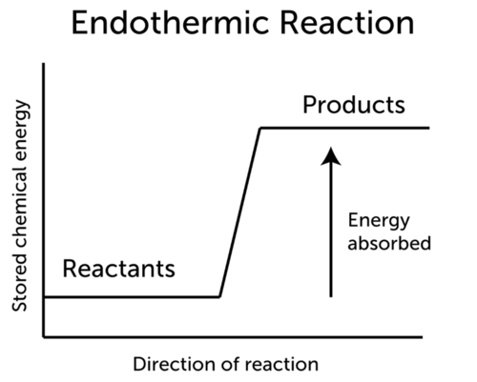
Concept Development
CFU 1
What is an endothermic reaction?
Endothermic Reactions
Reactions that absorb energy are called endothermic reactions.
The energy produced by breaking bonds in the reactants is not enough to form the products.
Extra energy is taken from the surroundings to make the products.
CFU 2
Where does the extra energy needed to make the products come from?
CFU 3
Explain why energy is taken from the surroundings.

Slide 16
Concept Development
CFU 1
How do we represent energy changes in chemical reactions?
Representing Exothermic and endothermic Reactions
The change in energy during a reaction can be shown in word equations by writing whether energy is absorbed or released above the arrow.
Energy is not a reactant or a product, so is not included on the reactants or products side of the equation.
CFU 2
Why is the energy change written above the arrow?
Reactants
Nitric acid + Zinc
Energy
released
Products
Zinc nitrate+ Hydrogen

Slide 17
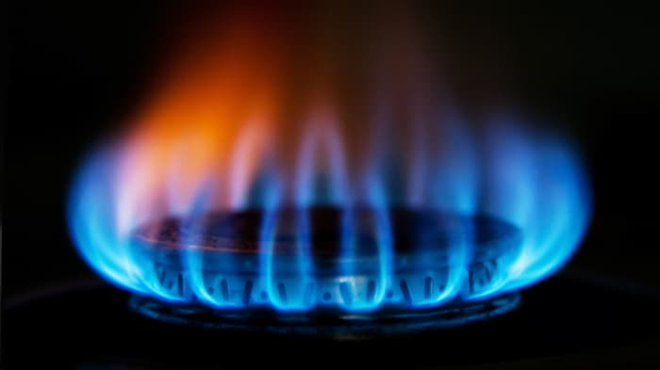
Skill Development / Guided Practice
Including Energy In Word Equations
Write a word equation for the chemical reaction.
Identify how the amount of energy changes (released or absorbed).
Write the energy change above the arrow in the word equation.
A large amount of energy is released when methane reacts with oxygen in air. This reaction produces carbon dioxide and water.
Energy
released
Methane + Oxygen
Carbon dioxide + Water

Slide 18
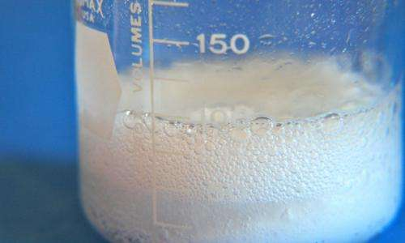
Skill Development / Guided Practice
Including Energy In Word Equations
Write a word equation for the chemical reaction.
Identify how the amount of energy changes (released or absorbed).
Write the energy change above the arrow in the word equation.
When citric acid and sodium bicarbonate react, the mixture feels cold to touch. This reaction produces sodium citrate, carbon dioxide and water.
Energy
absorbed
Citric acid + Sodium bicarbonate
Sodium citrate + Carbon dioxide + Water

Slide 19
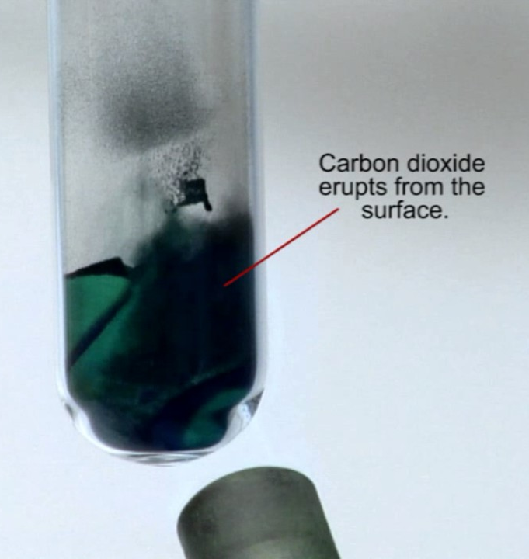
Skill Development / Guided Practice
Including Energy In Word Equations
Write a word equation for the chemical reaction.
Identify how the amount of energy changes (released or absorbed).
Write the energy change above the arrow in the word equation.
Carbon dioxide and copper oxide are formed when copper carbonate is heated.
Energy
absorbed
Copper carbonate
Copper oxide + Carbon dioxide

Slide 20
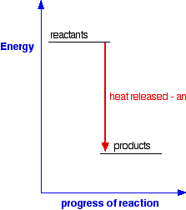
Skill Development / Guided Practice
Including Energy In Word Equations
Write a word equation for the chemical reaction.
Identify how the amount of energy changes (released or absorbed).
Write the energy change above the arrow in the word equation.
Carbon and Oxygen
Carbon and oxygen react together to form carbon dioxide.
Carbon dioxide
Energy
released
Carbon + Oxygen
Carbon dioxide

Slide 21
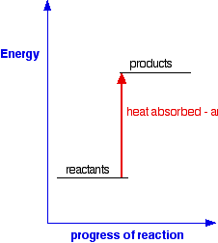
Skill Development / Guided Practice
Including Energy In Word Equations
Write a word equation for the chemical reaction.
Identify how the amount of energy changes (released or absorbed).
Write the energy change above the arrow in the word equation.
Sugar and Oxygen
In photosynthesis, carbon dioxide and water react together in the presence of sunlight. Sugars and oxygen are produced by the plant.
Carbon dioxide and Water
Energy
absorbed
Carbon dioxide + Water
Sugar + Oxygen

Slide 22
Relevance
Chemical reactions occur frequently in our daily lives, and can absorb or release energy.
When we cook food to eat or use an instant icepack, endothermic reactions are happening.
Exothermic reactions happen when we burn wood or fuel, and in instant hand warmers.
Scientists use chemical equations as a short and concise way to represent chemical reactions. The changes in energy can also be shown using chemical equations.

Slide 23
Skill Closure
Explain the difference between an exothermic and an endothermic reaction.
Skill Closure
What type of reaction is cooking a cake? Explain your choice.
Skill Closure
Write an equation to show the following reaction, including the energy change.
To release energy from our food, the human body reacts sugar and oxygen together. This produces two waste products, carbon dioxide and water.

Slide 24
Independent Practice
Complete the “Exothermic and Endothermic Reactions” worksheet on your device or on a paper copy.

